Slide 1
Web Scraping ‘Python’ {
HTML.html
intro.css
[HTML basics]
< Week 1>
}
CS Job Market Overview

Slide 2
00 {
[Basics]
project.html
intro.css
< Quick intro to the project >
}
CS Job Market Overview

Slide 3
Project‘workflow’ {
project.html
workflow.css
Step 01
Review necessary concepts for the project (HTML, Python, BeautifulSoup, Selenium,Pandas, Power BI/Tableau)
Step 02
Scrape LinkedIn, Glassdoor, ZipRecruiter, Indeed for job positions.
Step 03
Exploratory Data Analysis
Step 04
Dashboard
}
CS Job Market Overview

Slide 4
Planning of ‘Meetings’{
project.html
meetings.css
M | T | W | T | F | S | S
 |  | 01 | 02 | 03 | 04 | 05
06 | 07 | 08 | 09 | 10 | 11 | 12
13 | 14 | 15 | 16 | 17 | 18 | 19
20 | 21 | 22 | 23 | 24 | 25 | 26
27 | 28 | 29 | 30
10-15 min “Topic of the Day”
30 min sprint
Scrape, scrape, and scrape some more
Exploratory Data Analysis
Dashboarding
}
CS Job Market Overview

Slide 5
Table Of ‘Contents’ {
01
02
03
overview.html
contents.css
HTML Basics
< Basic HTML tags and scrips >
Libraries
< Libraries necessary for web scraping>
Web Scraping
< Let’s get coding>
}
CS Job Market Overview

Slide 6
01 {
[HTML]
Html_basics.html
intro.css
< Basics >
}
CS Job Market Overview

Slide 7
Tags < /1 > {
intro.html
Html_basics.css
<div> A container
<p> Paragraph
<h> Header
<li> Ordered list
}
Attributes < /2 > {
Our best friends for web scraping
< classes >
< id >
}
CS Job Market Overview

Slide 8

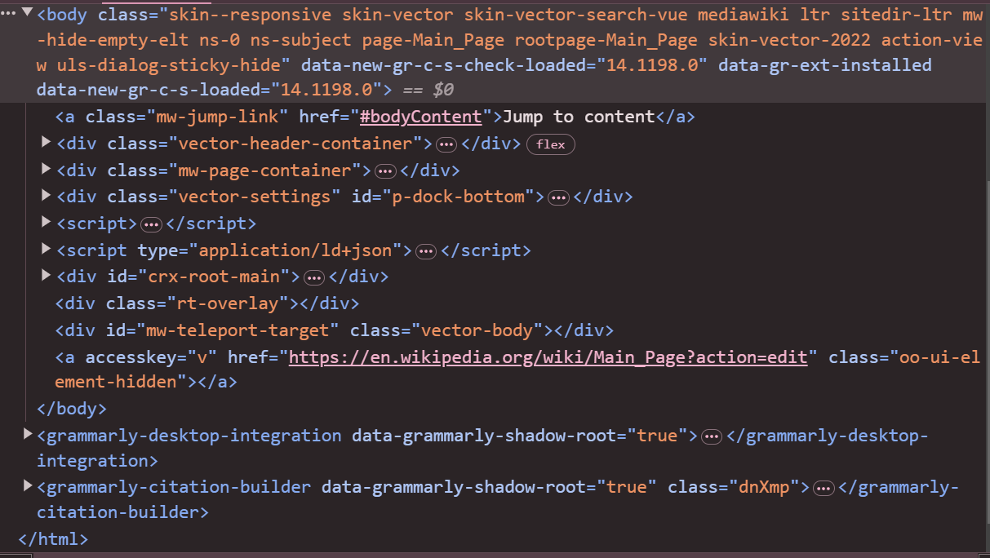
A ‘Picture’ Is { Worth a Thousand Words
}

Slide 9
02 {
[Libraries]
python.html
libraries.css
< Requests, BeatifulSoup >
}
CS Job Market Overview

Slide 10


Requests < /1 > {
python.html
libraries.css
import requests
response = requests.get(“url”)
}
BeautifulSoup < /2 > {
Our best friends for web scraping
from bs4 import BeautifulSoup
}
CS Job Market Overview

Slide 11
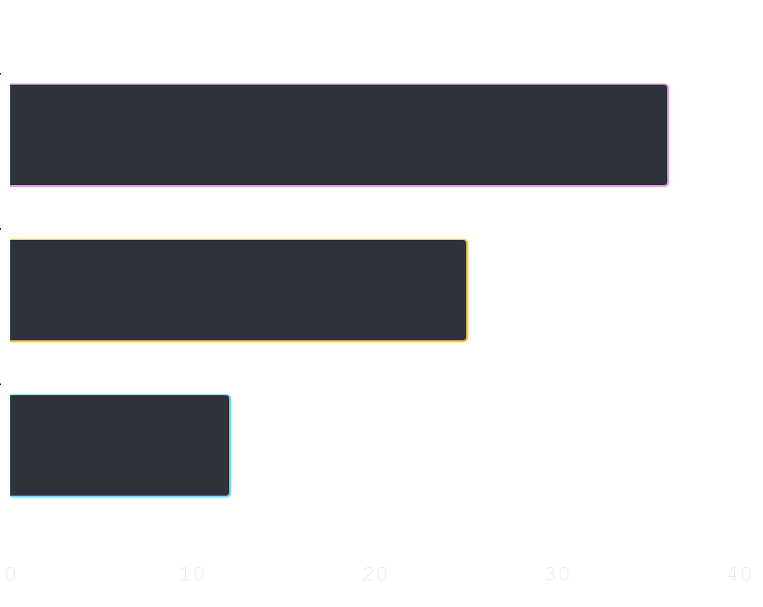
What does this ‘code’mean? {
libraries.html
requests.css
2xx
Request succeeded
3xx
Redirect request
4xx
Client error
}
More info
CS Job Market Overview

Slide 12
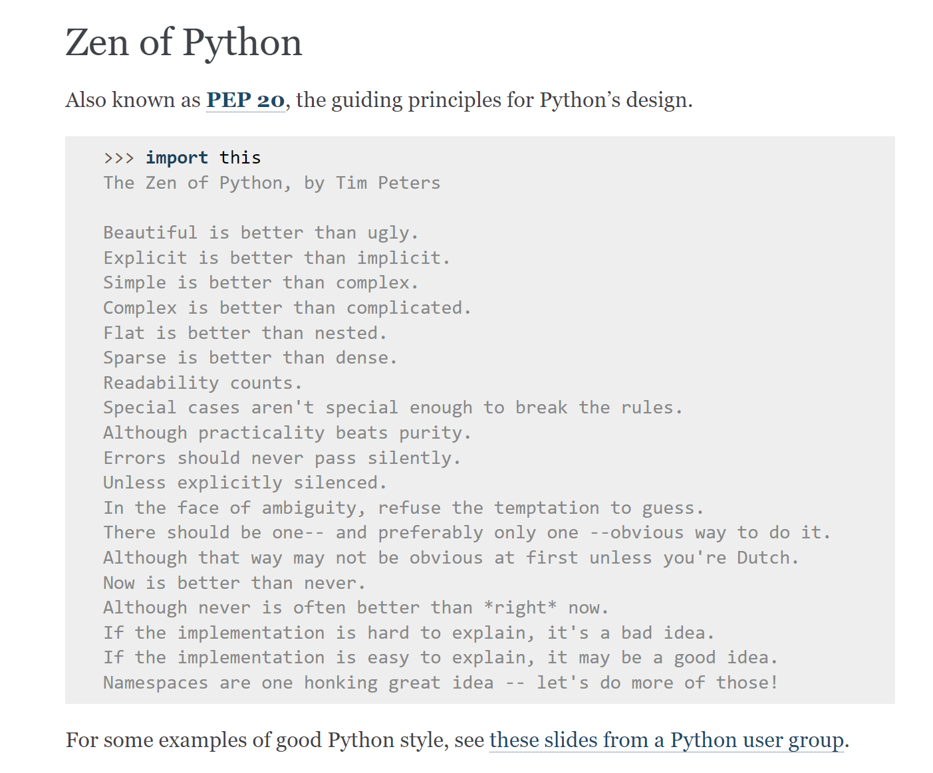
libraries.html
CS Job Market Overview

Slide 13
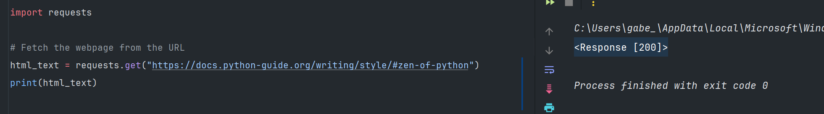
Example
libraries.html
requests.css
< Response [200]> means that we fetched the webpage successfully.
CS Job Market Overview

Slide 14
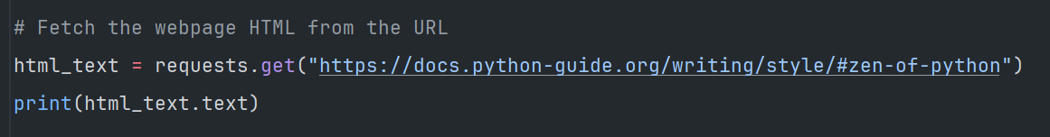
Let’s get the HTML
libraries.html
requests.css
CS Job Market Overview

Slide 15
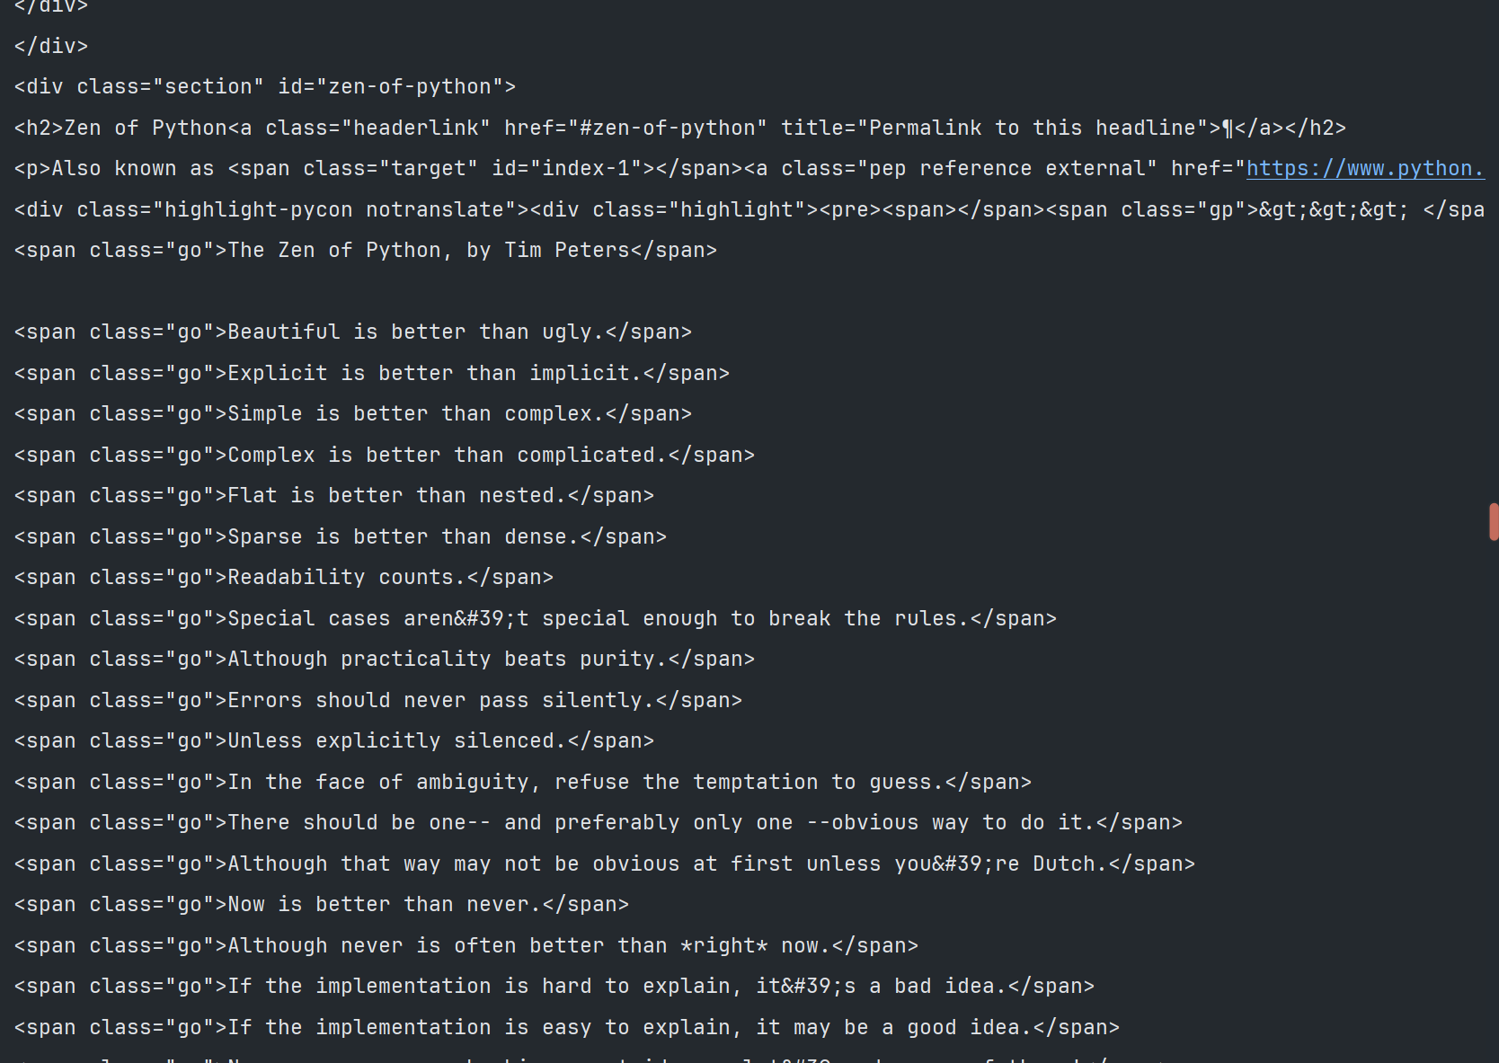
libraries.html
requests.css
< “ My human eyes can’t read this! Too polluted!” >

Slide 16
What { now?;
requets.html
HELP!!!!.css
}
CS Job Market Overview

Slide 17
— Someone ‘Famous’
BeatifulSoup.html
quote.css
< “Web scraping is a digital treasure hunt where the prize is data, and the map is HTML”>
CS Job Market Overview

Slide 18
< Let’s make some soup > {
python.html
beautifulSoup.css
from bs4 import BeautifulSoup
soup = BeautifulSoup(html_text, “html.parser”)
}
Let’s find some treasure{
zen_code = soup.find(id=“zen-of-python”)
}
CS Job Market Overview

Slide 19
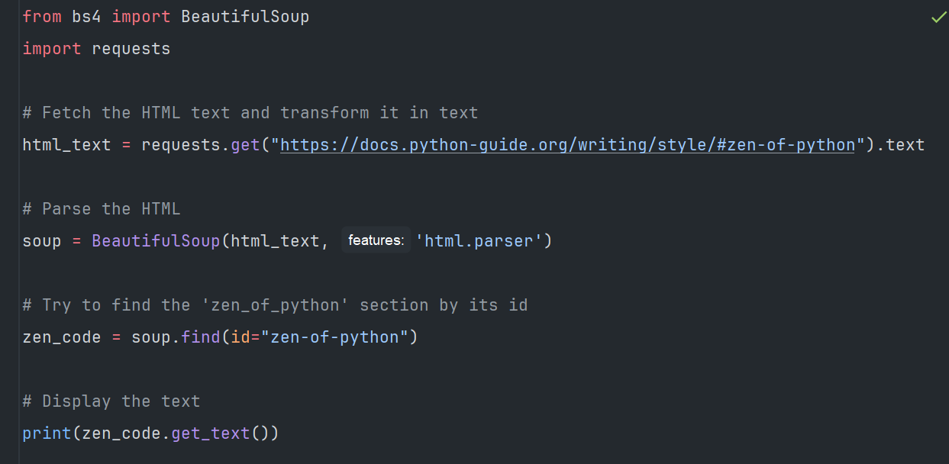
CS Job Market Overview

Slide 20
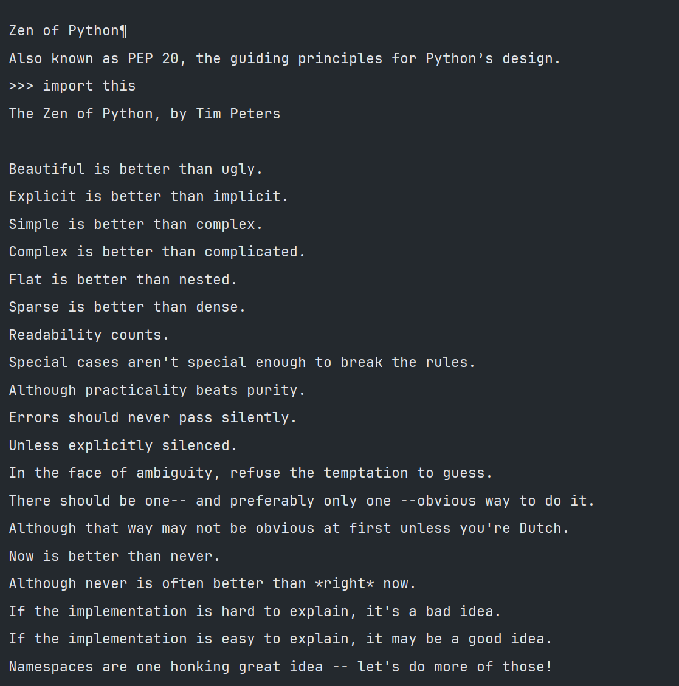
beautifulSoup.css
< “ Now I can read with my human eyes!”>

Slide 21
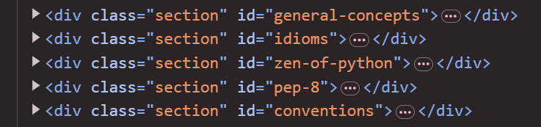
libraries.html
beautifulSoup.css
< “ What if I want to find all elements inside the section class?” >
CS Job Market Overview

Slide 22
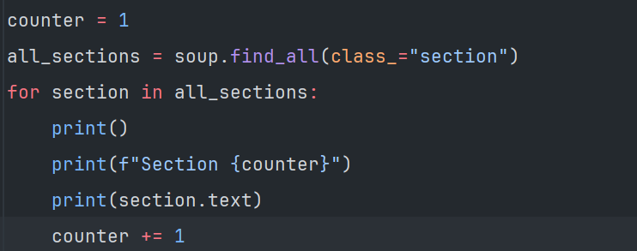
libraries.html
beautifulSoup.css
< “.find_all is the method we need to use” >
CS Job Market Overview

Slide 23
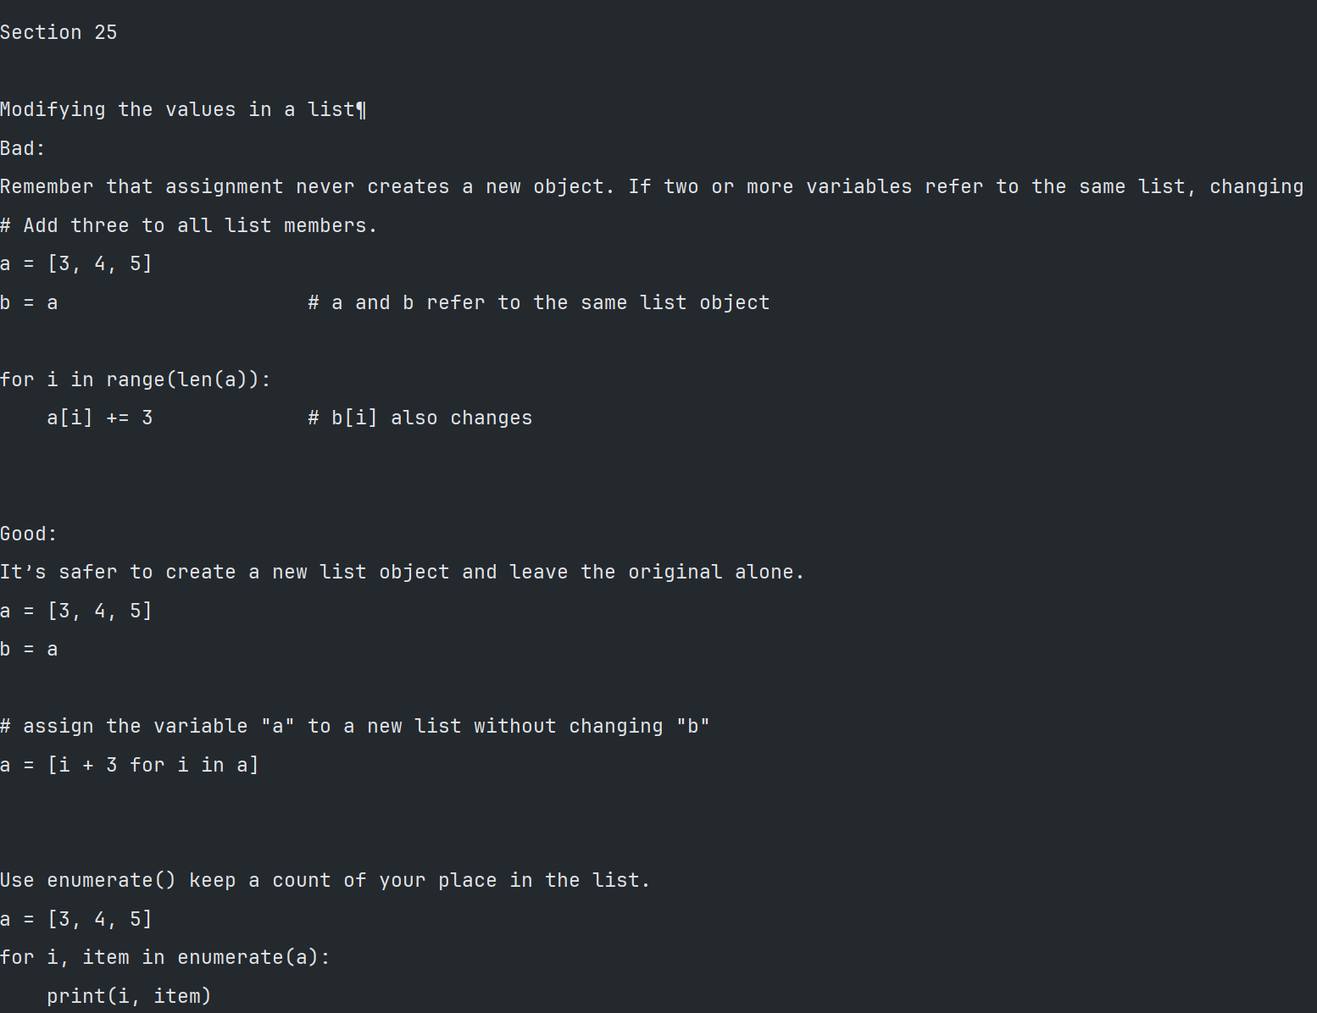
beautifulSoup.css
<“Too much white space for your liking? Worry not…” >

Slide 24
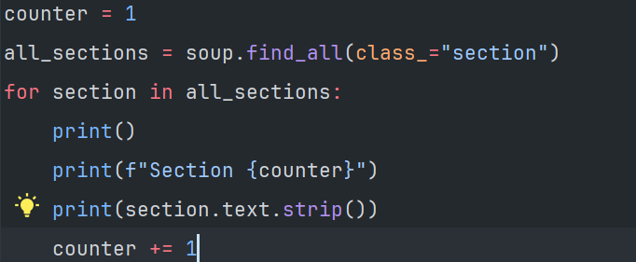
libraries.html
beautifulSoup.css
<“By calling the method .strip() it will strip most of the extra white space” >
CS Job Market Overview

Slide 25
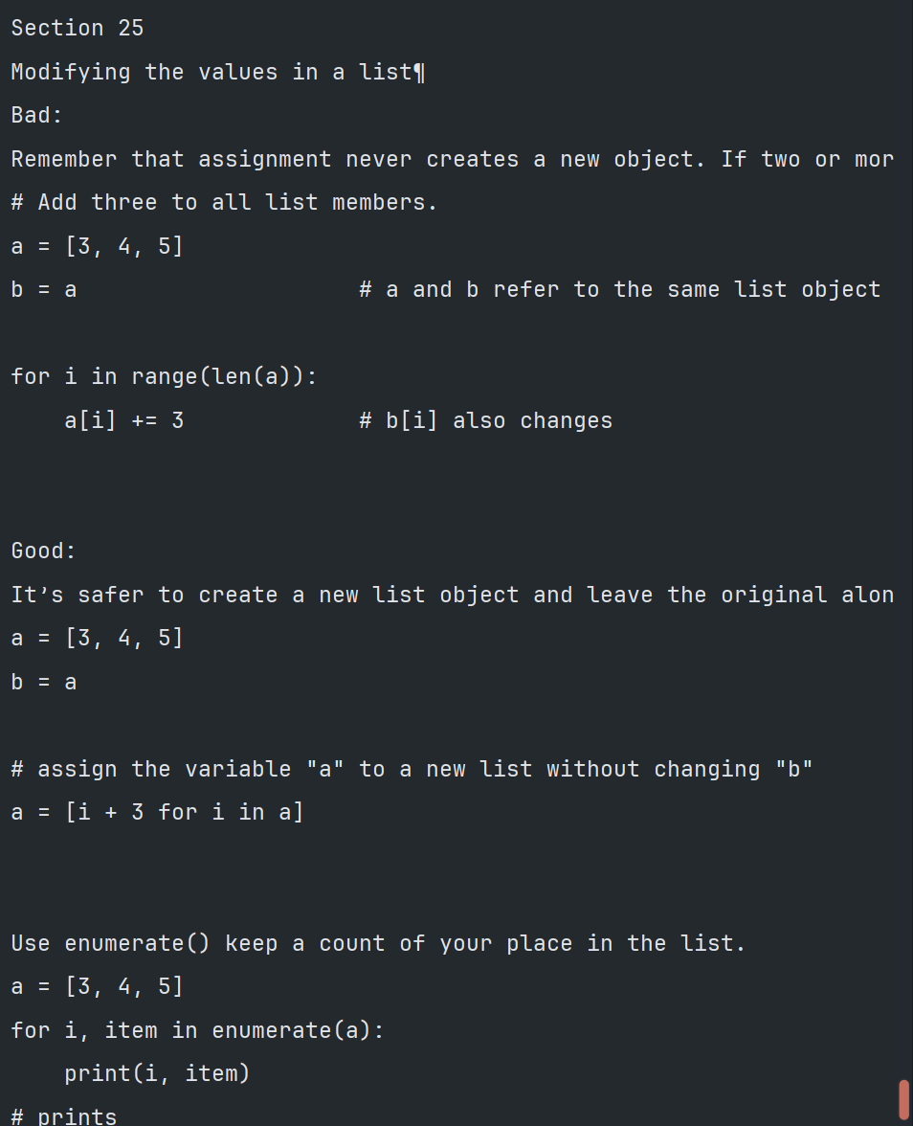

Slide 26
Now it’s your turn; {
python.html
sprint.css
‘Go to the Assets folder and access the Job listing website.’
<p Scrape all jobs positions and display them in the console>
</p>
}
CS Job Market Overview

Slide 27
Thanks; {
python.html
ThankYou.css
‘Do you have any questions?’
Shoot me a message on discord
@Barderus
< Please keep this slide for attribution >
}
CS Job Market Overview

